Slide 1

The Sacraments at the Service of Communion:
Holy Orders
IHM
OCIA

Slide 2
Sacrament
Outward sign, instituted by Christ, gives grace
Greek mysterion: something hidden, something revealed
Only with the eyes of faith can we see the underlying reality of the graces received: the fruits of the sacrament

Slide 3
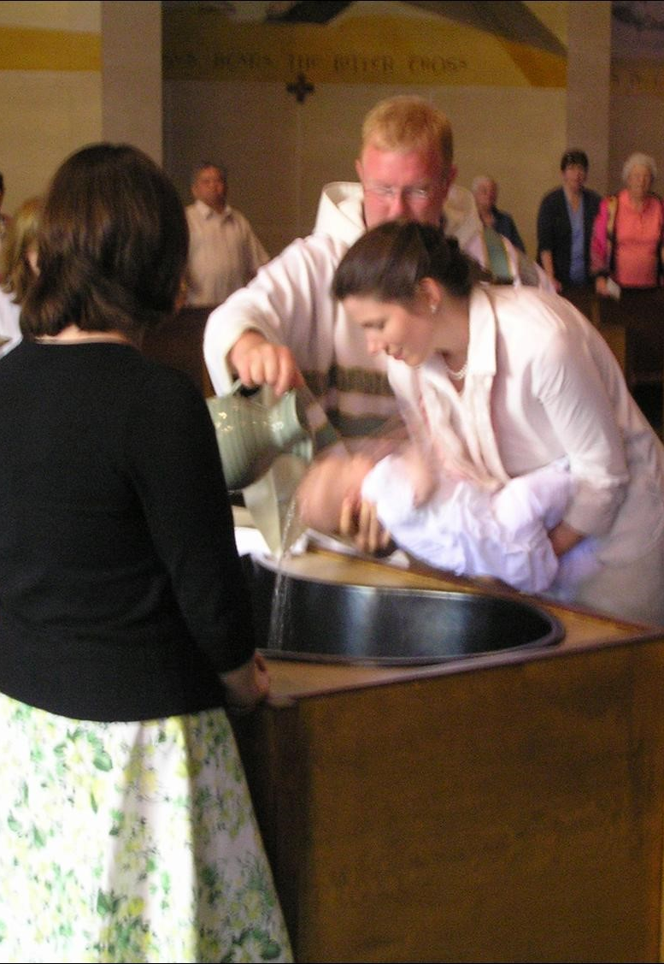
Baptism – Confirmation - Eucharist
The sacraments of Christian initiation
The common vocation of all Christ’s disciples, a vocation to holiness and to the mission given by Christ to spread the good news!
Notes:
Christ came into the world to proclaim the good news of God’s mercy and salvation (Luke 4)
Through our baptism, we share in the common priesthood; we are anointed a priest who prays, and invites others to pray, we offer sacriface.
Our common mission given by Christ to go out to all nations, teaching them, and baptizing them in the name of the Trinity.

Slide 4
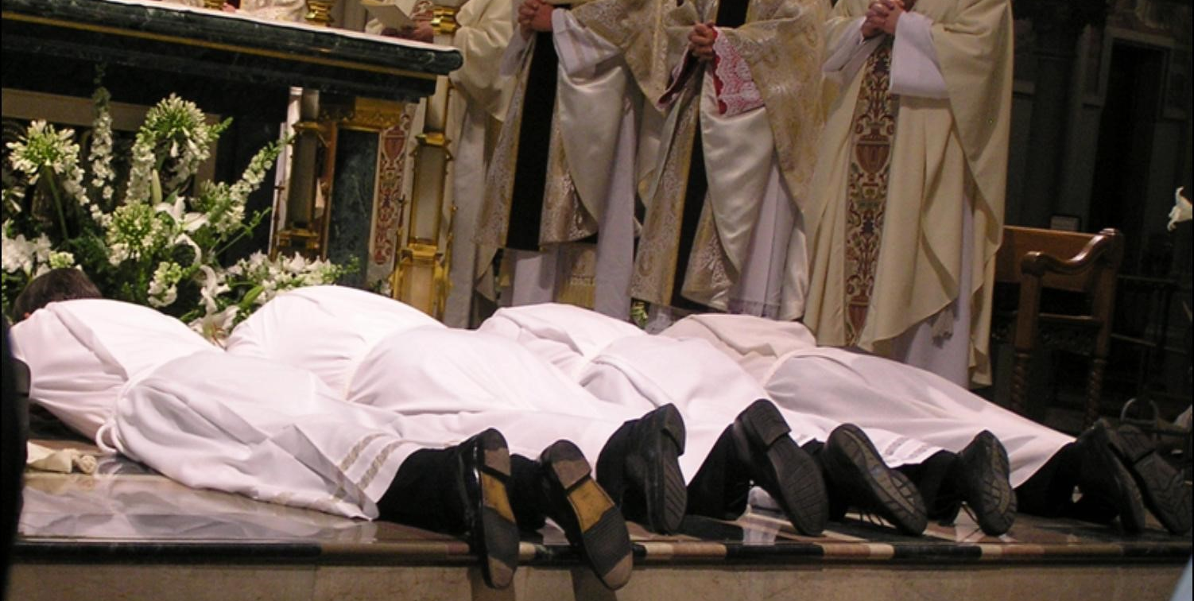
Holy Orders and Matrimony
Sacraments of service and mission
Directed toward the salvation of others
Confers a particular mission in the Church
Serves to build up the people of God.

Slide 5
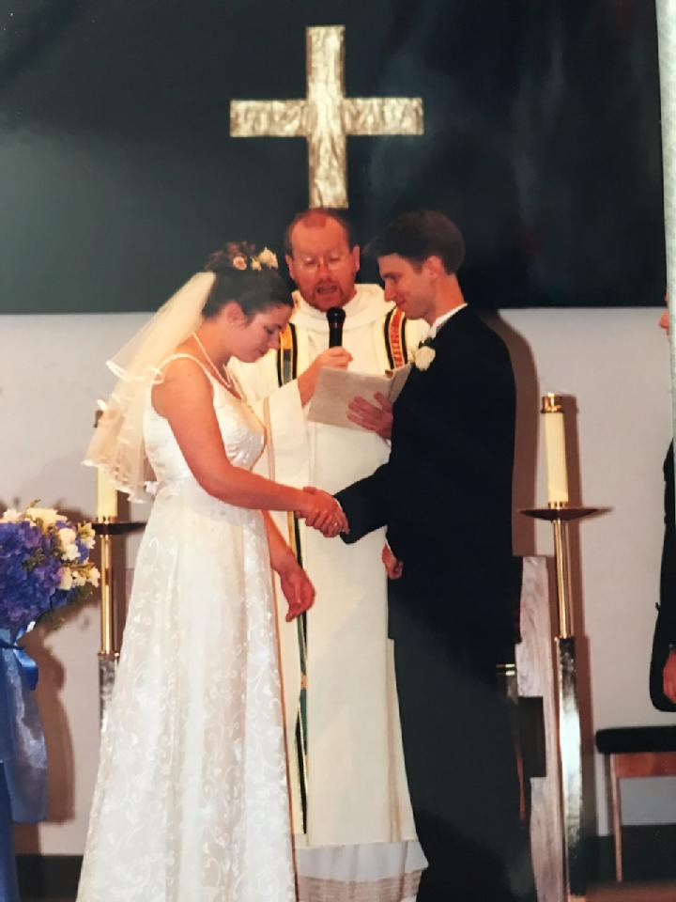
Matrimony
Christian spouses are fortified, as it were consecrated, for the duties and dignity of their state by a special sacrament.
Notes:
The sacramental nature of marriage is such that the sign is the love of the married couple for each other; they live as a sign of God’s love for each other, and of us.

Slide 6
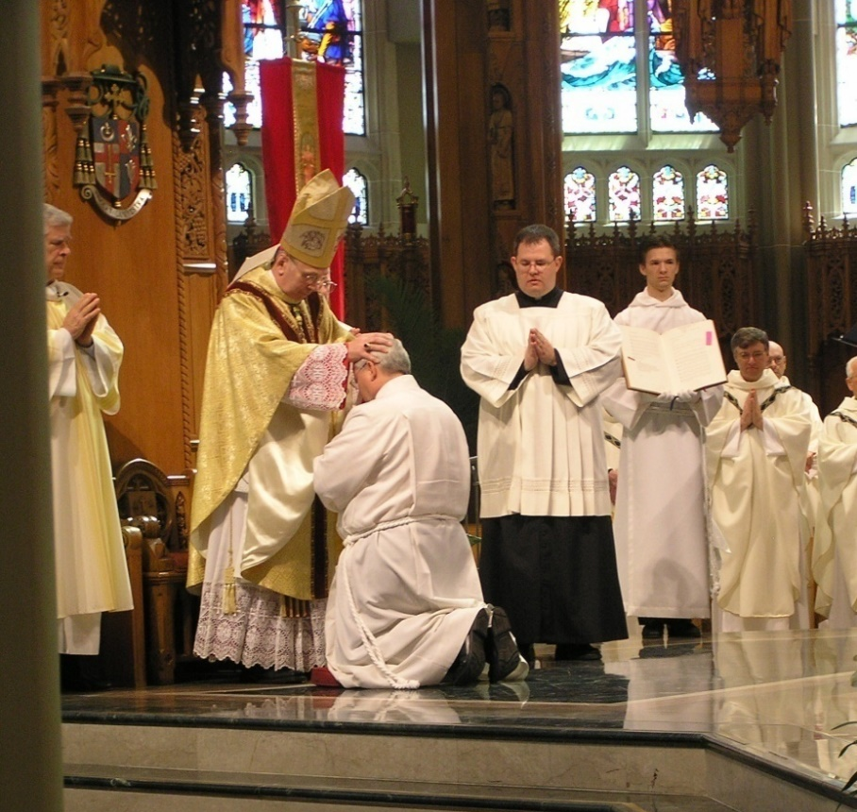
Those who receive Holy Orders are consecrated (set aside) in Christ’s name to feed the church by the word and grace of God.

Slide 7
Holy Orders:
The sacrament of apostolic ministry
The sacrament through which the mission entrusted by Christ to his apostles continues to be exercised in the Church until the end of time
It includes 3 degrees:
  Episcopate (Bishop)
  Presbyterate (Priest)
  Diaconate (Deacon)
Christ is the source of all ministry
Notes:
Christ is our High Priest (Heb 7:25-26)
All of the baptized share in Christ’s priesthood.
The ministerial priesthood shares this through the Sacrament of Holy Orders in a special way.
3 degrees of Holy Orders

Slide 8
Orders
“Order” is a designation that refers to a particular body.
Familiar with Episcopal order (bishop), priestly order (priests) and diaconal order (deacons).
Traditionally, also order of catechumens, virgins, spouses and widows.
Institution into an “order” was achieved by a liturgical rite, ordinatio, which conferred a consecration, blessing, or sacrament.
Today, the word ordination is reserved for the rite that integrates a man into the order of bishop, priest, or deacon—Holy Orders.

Slide 9
Priesthood in Hebrew Scriptures
Official priesthood nor one central place of worship not found in early history.
Offering of sacrifice and acts of formal worship performed by head of the house
Abraham (Gen 22:9-13)
The only “priests” in Genesis are gentiles: Gen 14:18-20 is Melchizedek
Notes:
In the OT we learn of the patriarchal nature of the priesthood, the father, the head of the house, had a special role in their worship which was decentralized.
Abraham (page 24): the story of Abraham’s great test of faith in offering sacrifice of his son, Isaac, and then the ram.

Slide 10

Priests in History
As rituals became more elaborate, and central places of worship rise, a distinct class of people called priests emerges.
Duty is to perform traditional rituals at appointed times for invoking the favor of the divinity. Usually done at sacred places, temples, shrines, etc.
Most characteristic is the offering of sacrifice, offering of gifts to God to placate anger and to gain protection and favor.

Slide 11
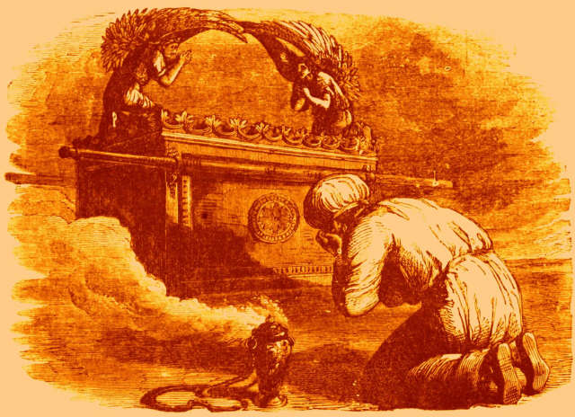
Priesthood of the Old Covenant
Priesthood arises in Israelites after the Exodus
  (Ex 28:1; 28:40; 29:1+…p.86)
Notes:
God revealed the Law to Moses and instructed Moses to construct a sanctuary—a holy place—where God may dwell among the people, and to consecrate priests to serve Him there.
Priests sacred to God in the sense they were consecrated and set aside for service of God (Numbers 8:14, Deut 10:8)
Deut: At that time the LORD set apart the tribe of Levi to carry the ark of the covenant of the LORD,^{h} to stand before the LORD to minister to him, and to bless in his name, as they have done to this day
Ex 28 describes ornate vestments the priests (sons of Aaron) are to wear when performing their priestly duties

Slide 12

Role of the OT Priest
Seek
Seek Guidance from the Lord
Teach
Teach the Law (Deut 33:10)
Offer
Offer Sacrifice (Heb 5:1-3)
Served as mediator between God and the people
Heb 5:1

Slide 13
One Priesthood of Christ
Priesthood of the Old Testament “prefigured” Christ: the “one mediator between God and man.”
1 Tim 2:5
“For there is one God.
There is also one mediator between God and the human race, Christ Jesus, himself human, who gave himself as ransom for all.”
Notes:
p. 323 in bible
COCC #1545: The redemptive sacrifice of Christ is unique, accomplished once for all; yet it is made present in the Eucharistic sacrifice of the church. The same is true of the one priesthood of Christ: it is made present through the ministerial priesthood without diminishing the uniqueness of Christ's priesthood. Only Christ is the true priest, the others being only his ministers. (St Thomas Aquinas, Heb 8,4
Letter to Hebrews discusses the Priesthood of Jesus

Slide 14
Christ as High Priest (1 Tim 2:5)
See John 20: 21-23
Jesus described his ministry at the Synagogue, Luke 4:18 quoting Isaiah 61
Since the mission of the priest is a participation in the mission of Jesus Christ, the passage of Isaiah also describes the priest’s task.
Notes:
* [Jesus] said to them again,^{l} “Peace be with you. As the Father has sent me, so I send you.”
22* And when he had said this, he breathed on them and said to them,^{m} “Receive the holy Spirit.
23* ^{n} Whose sins you forgive are forgiven them, and whose sins you retain are retained.”
* The spirit of the Lord GOD is upon me,
because the LORD has anointed me;
He has sent me to bring good news to the afflicted,
to bind up the brokenhearted,
To proclaim liberty to the captives,
release to the prisoners,ª
2To announce a year of favor from the LORD
and a day of vindication by our God;
To comfort all who mourn;^{b}
3to place on those who mourn in Zion
a diadem instead of ashes,

Slide 15
Two Participations in Priesthood of Christ
The Church is a “kingdom of priests for his God and Father”
Anointed “priest” at Baptism
Exercise baptismal priesthood by participating in Christ’s mission as priest, prophet and king.
1 Peter 2:9+
“…you are a chosen race, a royal priesthood, a people of his own so that you may announce the praises of him who called you out of darkness into his wonderful light.”

Slide 16
Two Participations in Priesthood of Christ
Ministerial priesthood is at the service of the common priesthood (baptismal)
Directed at the unfolding of the baptismal grace of all Christians
The means by which Christ unceasingly builds up and leads his Church
Transmitted by the Sacrament of Holy Orders

Slide 17
Holy Orders is a Sacrament
Instituted by Jesus when He gave authority to apostles
Matthew 16: 13-19 (you are rock, Peter)
Luke 10 (appointment of the 72)
John 20: 19-23 (Receive the Holy Spirit)

Slide 18
Apostolic Succession
Peter recognizes ministry must continue
  Acts 1:15-26 (choice of Judas’s successor)
  Acts 6:1-7 (first seven deacons)
1 Timothy
  Qualifications for Bishops and Deacons
  Laying on of hands described at 4:14

Slide 19
Three Degrees
Episcopal ordination: the fullness of Holy Orders (Bishops)
Priestly ordination: co-workers of the Bishops
Diaconal ordination: in order to serve
Bishop confers the sacrament as the successor to the Apostles

Slide 20
Question of Validity
Since it is Christ who acts and effects salvation through the ordained minister, the unworthiness of the minister does not prevent Christ from acting.
Notes:
Donatists were heresy that said the Church had to be without sinners….especially the priests. St Augustine led the charge against the heresy

Slide 21
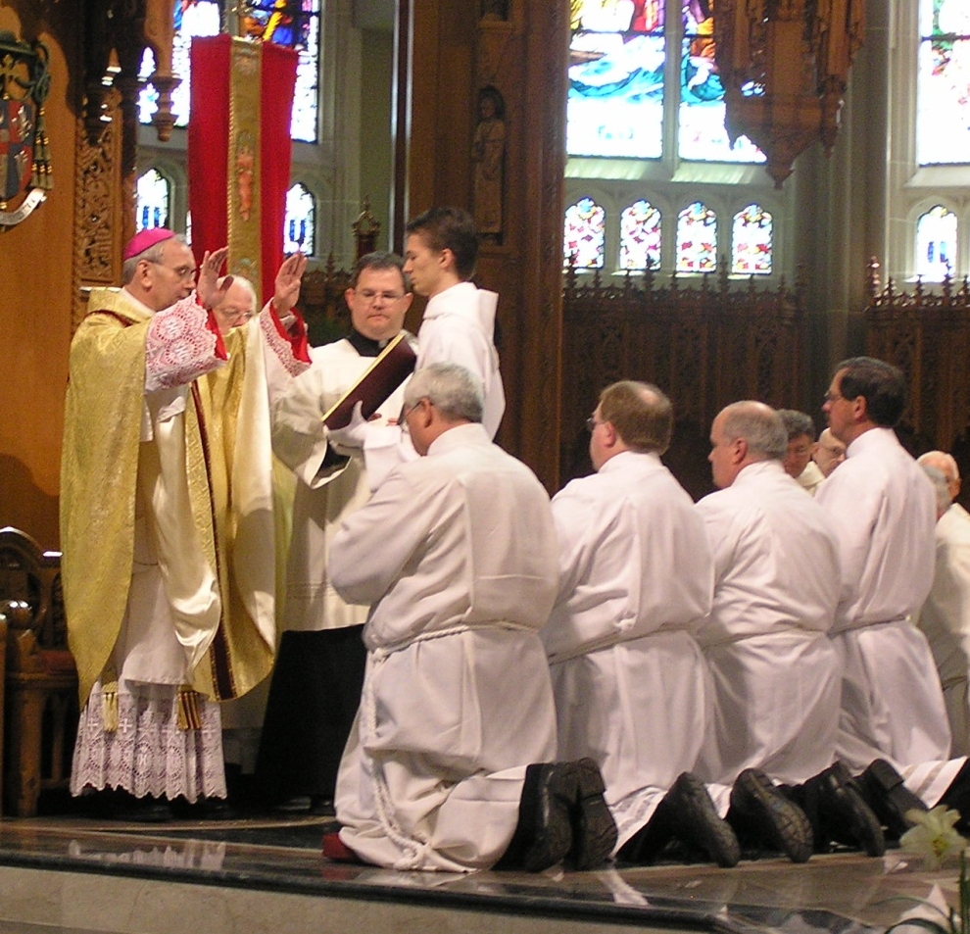
Ordination
Confers indelible mark on soul
“Matter” is laying on of hands by Bishop
“Form” is prayer of ordination

Slide 22
Fruits of the Sacrament
Grace of the Holy Spirit
  Configuration to Christ as Priest, Teacher and Pastor
Grace of Strength
  A governing spirit
  Grace to guide and defend His Church with prudence and strength as a father, with gratuitous love for all and a preferential love for the poor, the sick and the needy.
  Proclaim the Gospel
Notes:
Lord, fill with the gift of the holy spirit him whom you have deigned to raise to the rank of the priesthood, that he may be worthy to stand without reproach before your altar, to proclaim the gospel of your kingdom, to fulfill the ministry of your word of truth, to offer you spiritual gifts and sacrifiaces, to renew your people by the bath of rebirth; so that he may go out to meet our great God and Savior Jesus Christ, your only son, on the day of his second coming, and may receive from your vast goodness the recompense for a faithful administration of his order.
Byzantine Rite of Ordination

Slide 23
The Call
Calling from God and a privilege
Not a right
Discernment by individual and Church
Notes:
My story:
Growing up Catholic; serving at 4th grade (in Latin)
Active in church through high school and college
In army, people peers/sub/sup seeking advice and counsel
Avoided religious conversations as I found many to be hateful and prejudicial;
Mr. Cortesman in Chicago
PA talks with Fr. Mark; acceptance to seek possible calling to do more
Retreat: unknown woman asking when will I be ordained?
Sgt Rierson, hateful, prejudiced, wife RCIA, daughter, prodigal son, father’s mercy and love
Nancy how long a deacon? Act like her idea of deacon; helpful, getting mission done but always with respect
Mary at Gert’s funeral to chaplain “he will be ordained deacon”
Canonical retreat, prayer speak Lord; whom shall I send, here I am
Acceptance, peace
Touched by Holy Spirit while laying on cold marble floor while church prayed litany

Slide 24
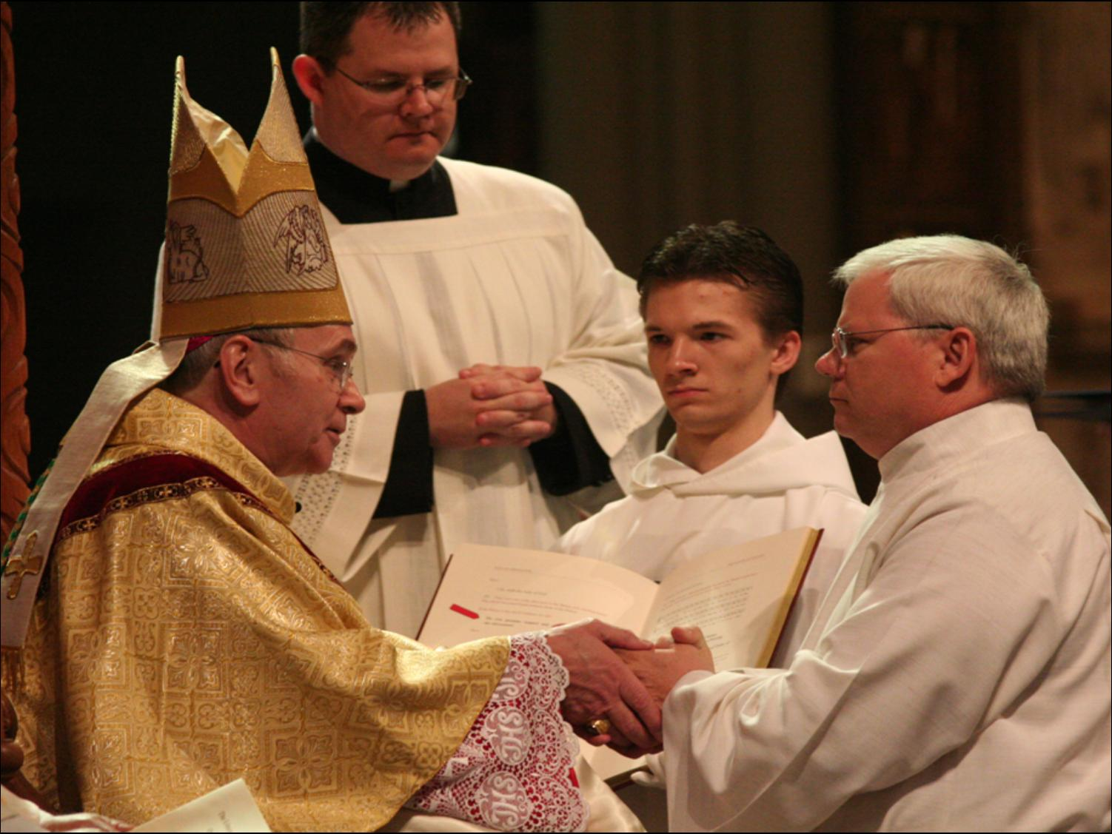

Slide 25
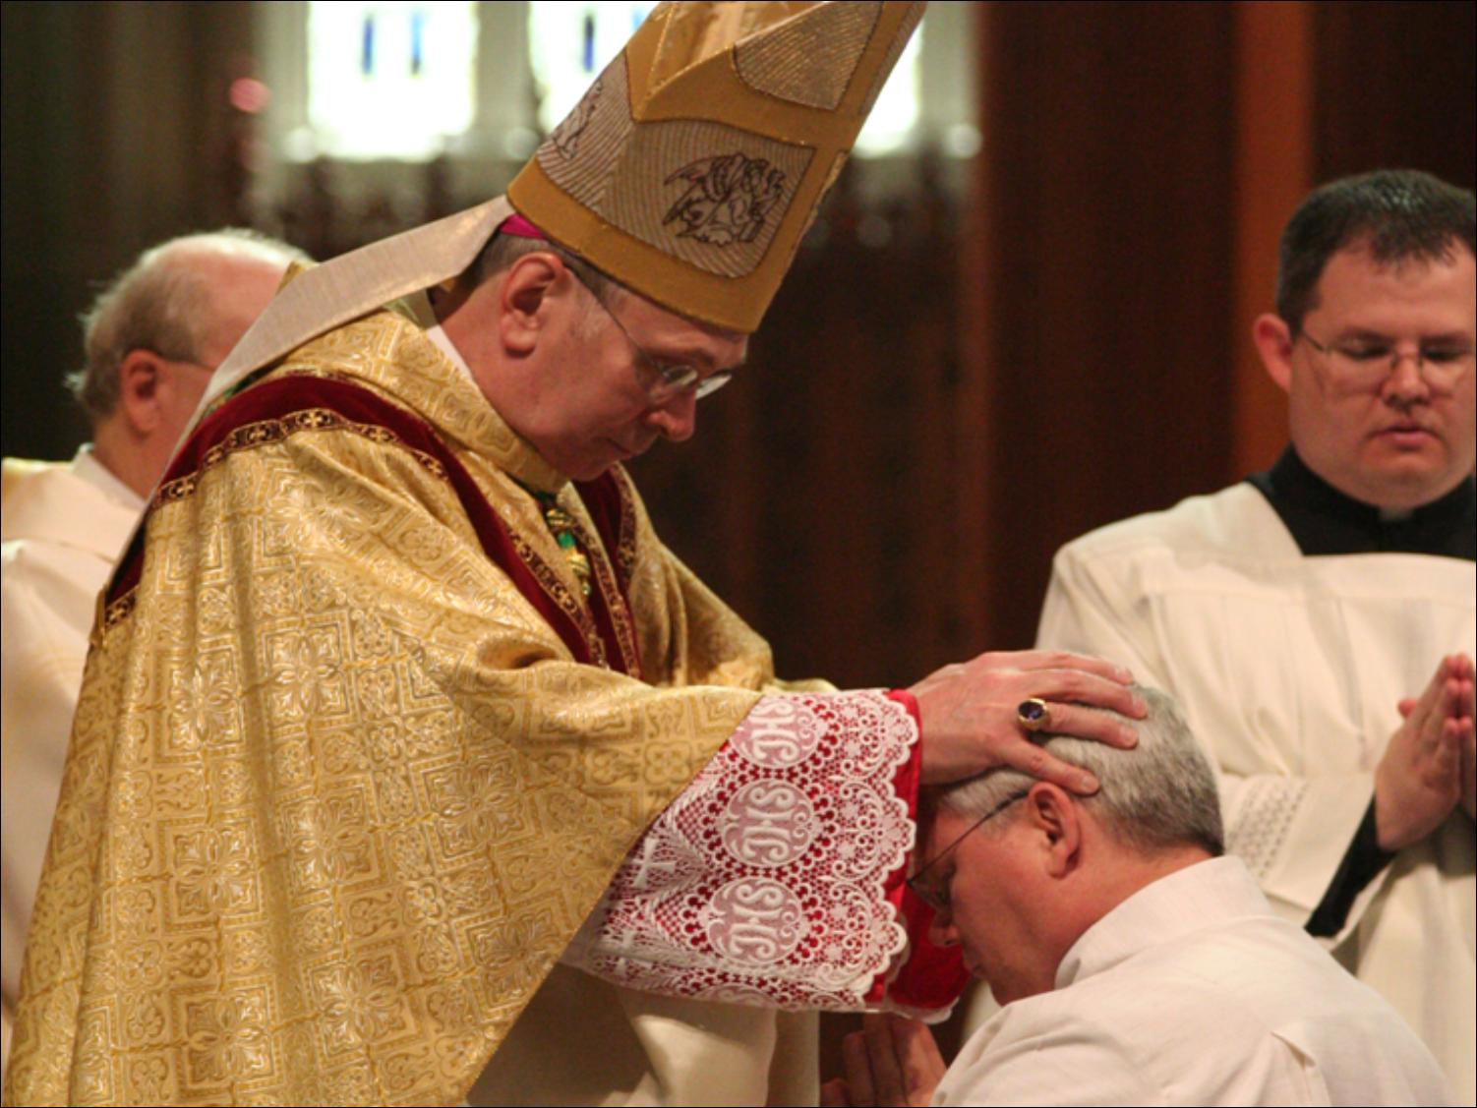

Slide 26
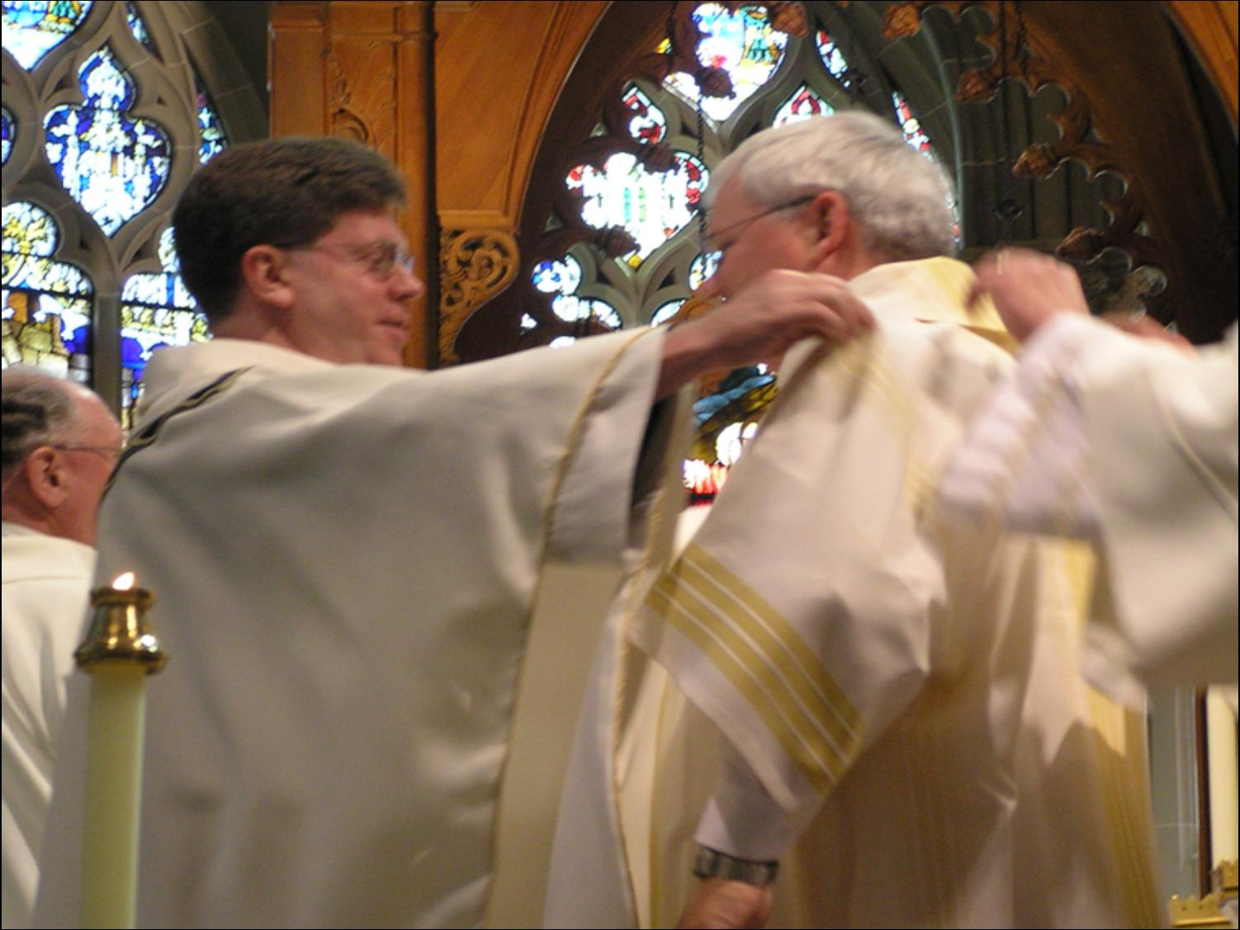

Slide 27
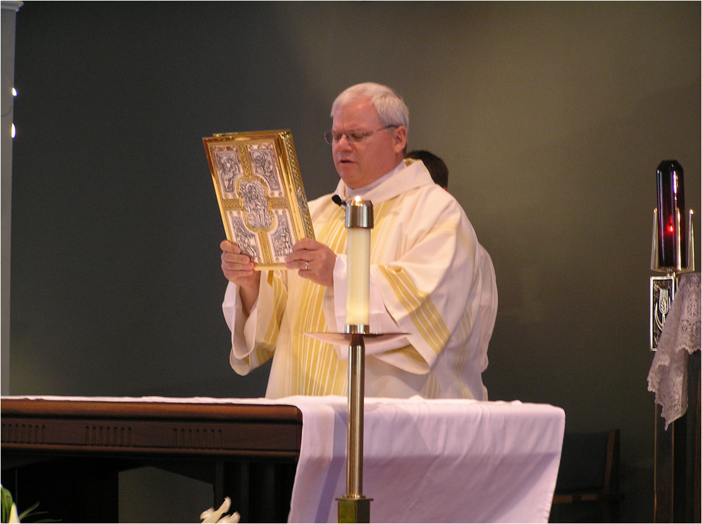

Slide 28
Questions?
Notes:
Participate I ministry of Christ
Apostolic succession through bishops
God qualified the called
Persona Christi, validity

Slide 29
Why Only Men?
Christ chose men as the 12 apostles
Apostles choose men as successors
Church recognizes herself to be bound by the choice made by the Lord
Church has no power to correct the Lord
Women not inferior or less holy
All Created in image of God
Notes:
Demand for priestesses is very recent in the history of humanity in Judaism and Christianity
Demand is very local, limited to Western Europe and North America
Demand is very secular, derived from secular feminism with a language of demands and rights.
A demand for ordination as “empowerment” which is a radical misunderstanding of the priesthood.
Priesthood is for service, not power.
No one has a right to receive the sacrament of holy orders
No one claims this office for himself, he is called to it by God and he submits himself humbly to the authority of the church…sacrament can only be received as an unmerited gift—like all sacraments.

Slide 30
Why Celibacy?
All ministers in the Latin Church
Called to consecrate themselves with undivided heart to the Lord and to the affairs of the Lord (1 Cor 7:32)
A discipline and witness
Orders is an impediment to Matrimony

